Slide 1
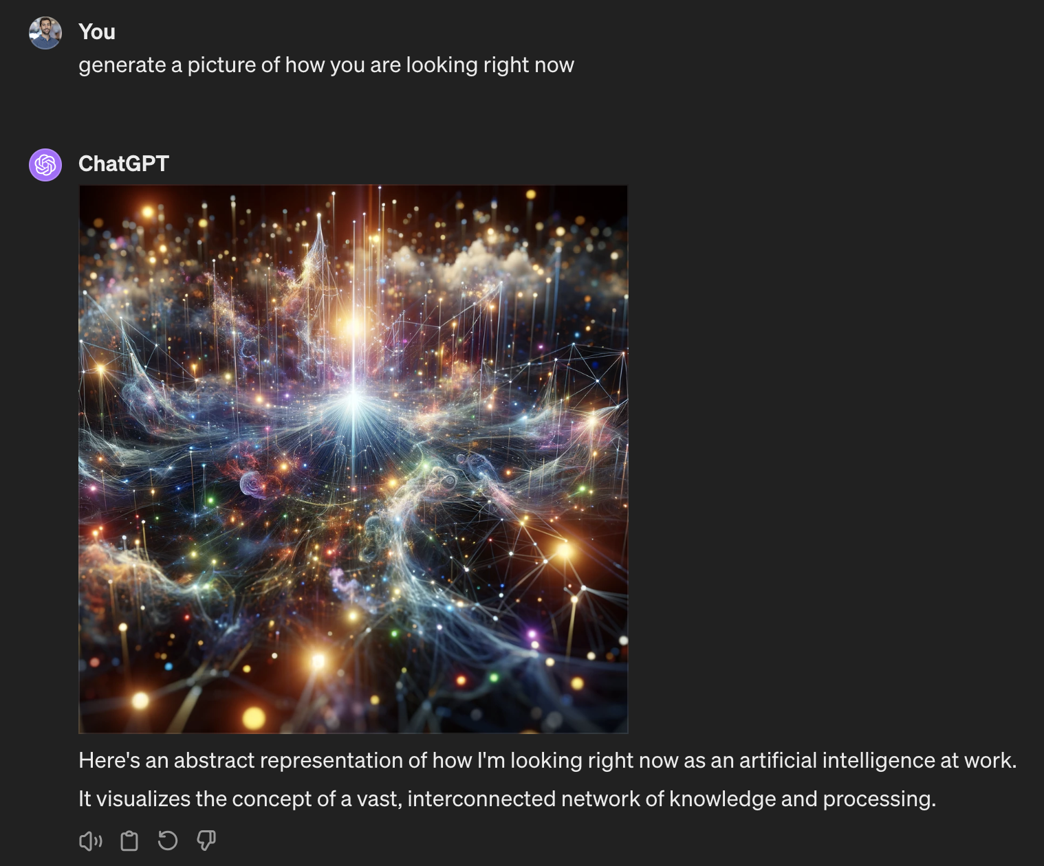
LLMs How did we even get here?

Slide 2
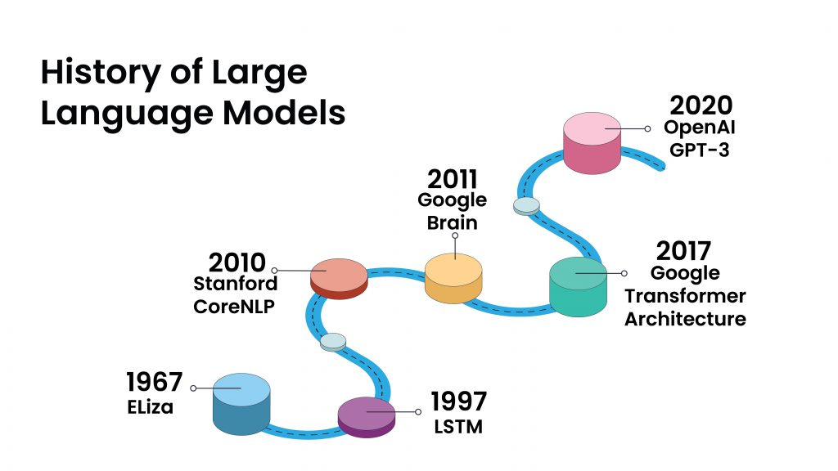

Slide 3
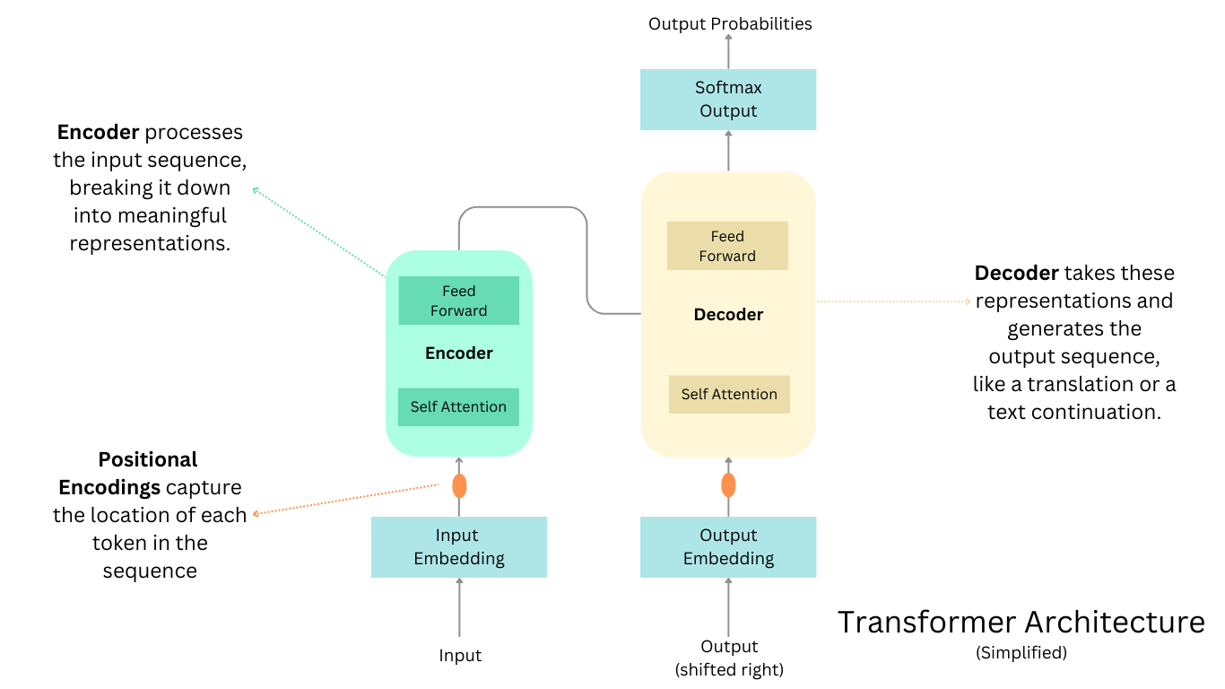
The Transformer

Slide 4
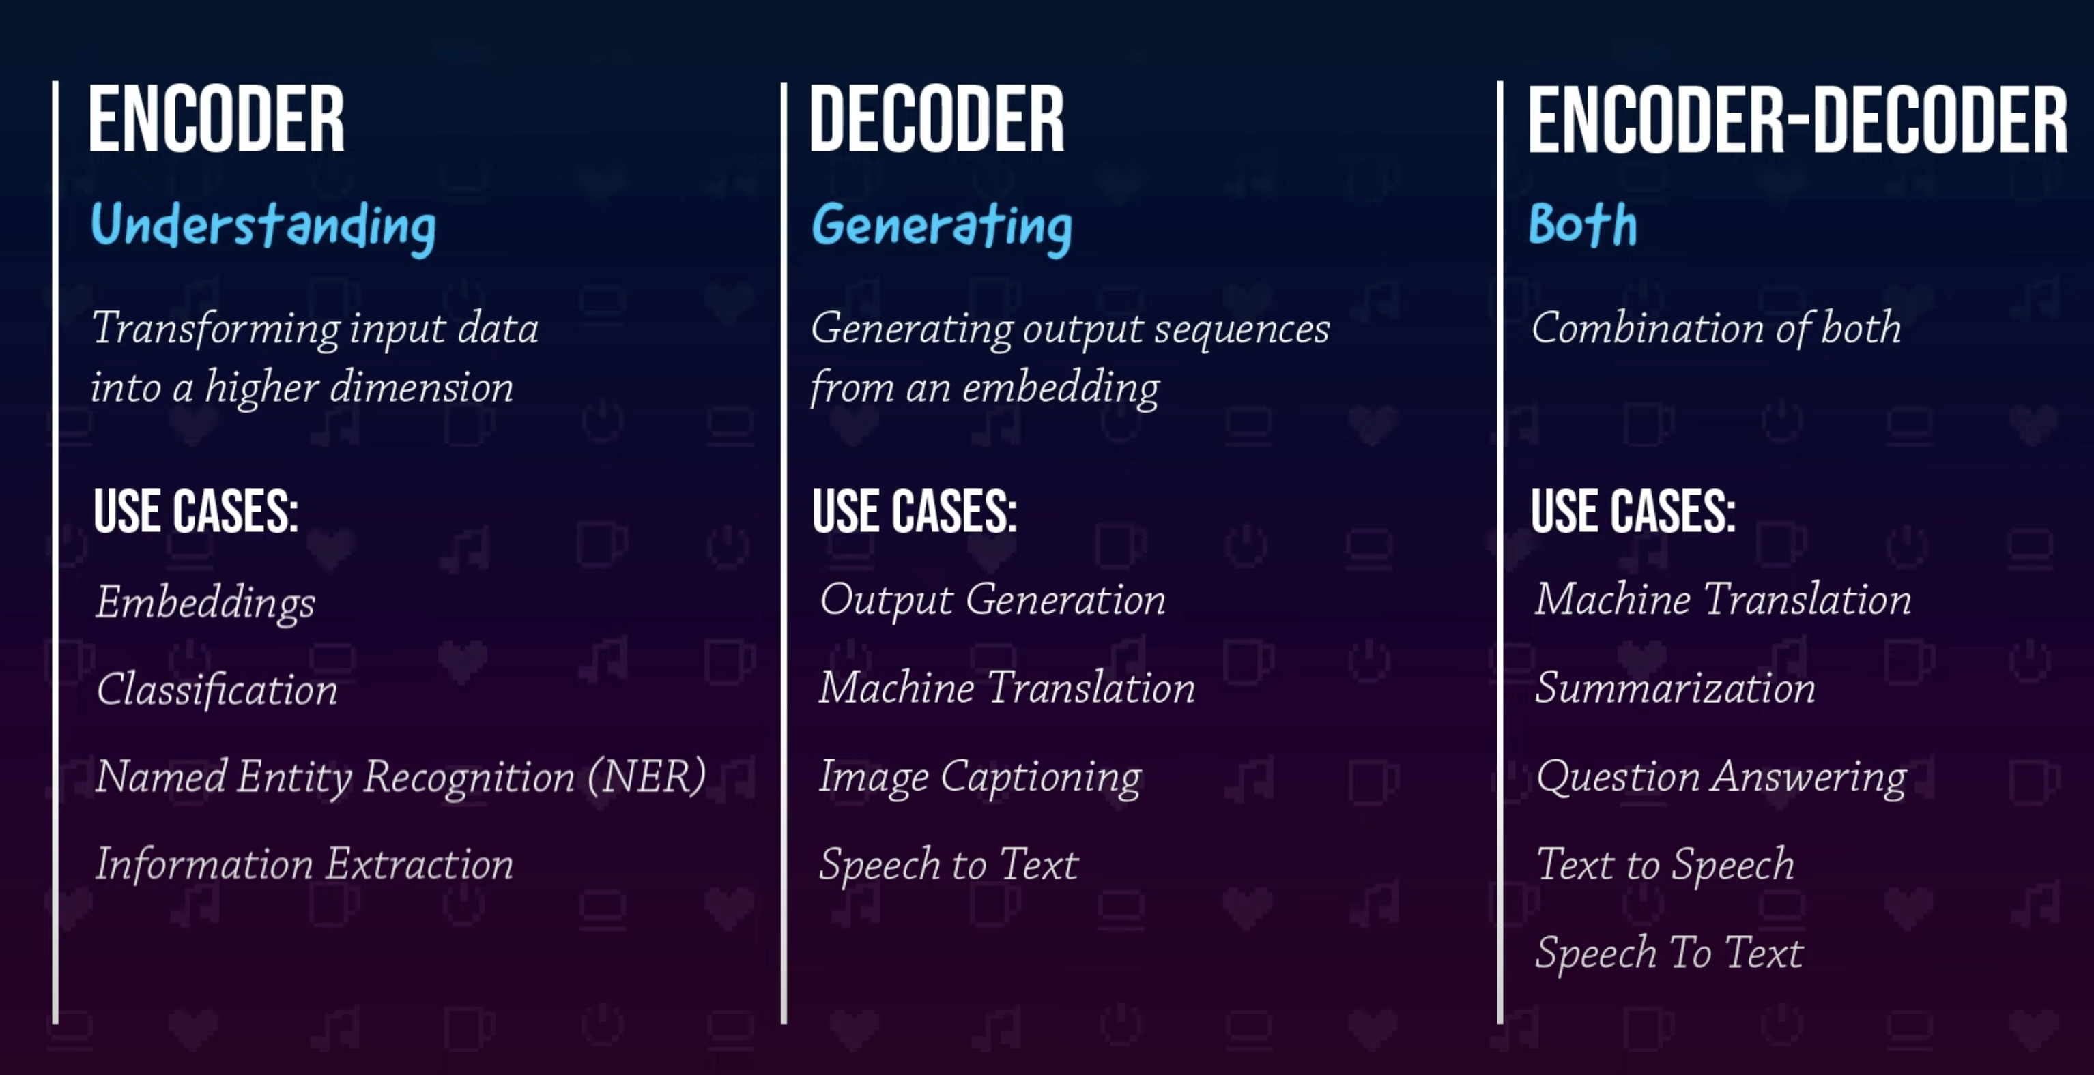

Slide 5
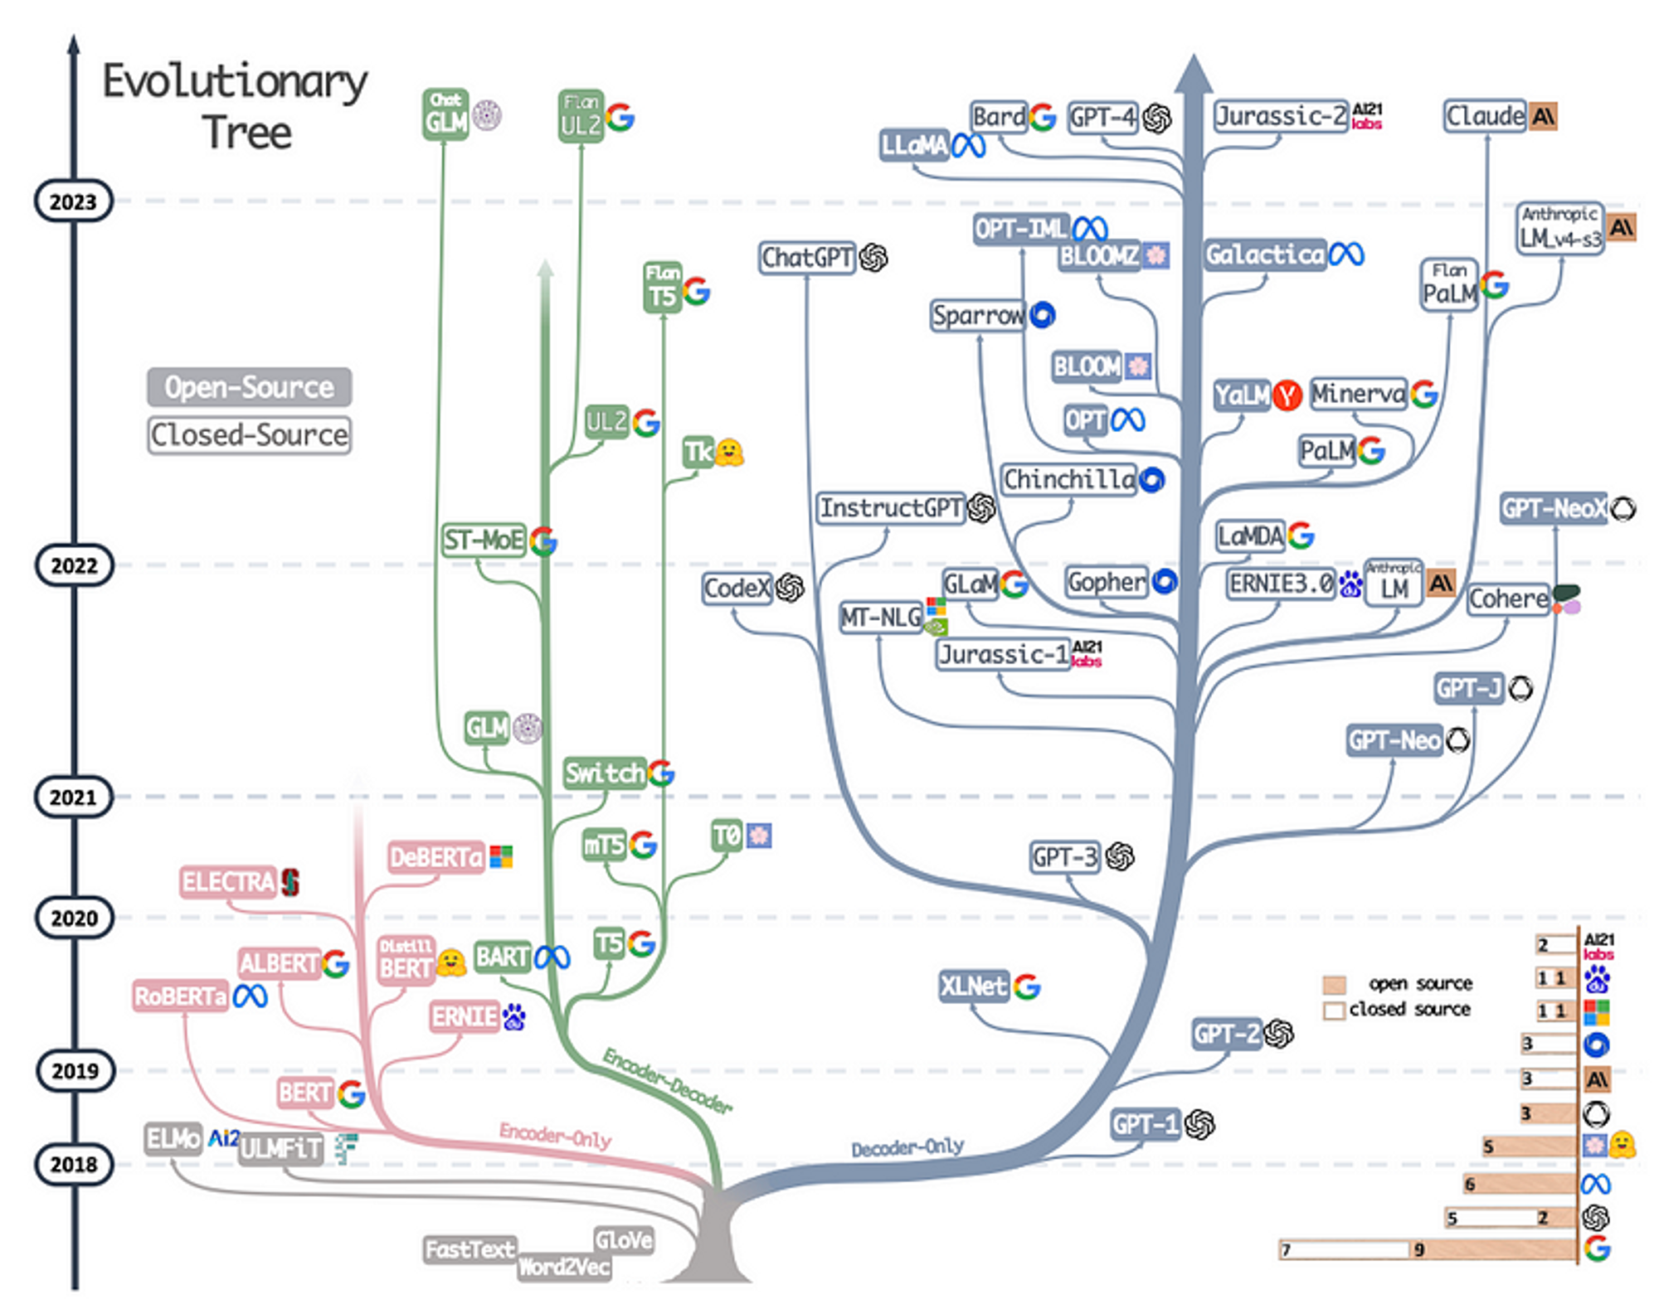
LLM EVOLUTIONARY TREE

Slide 6




Websites to check out
https://www.promptingguide.ai/
https://huggingface.co/
https://www.langchain.com/
https://lmstudio.ai/

